Slide 1
Introduction and Overview
Computer Networks Nick Feamster

Slide 2
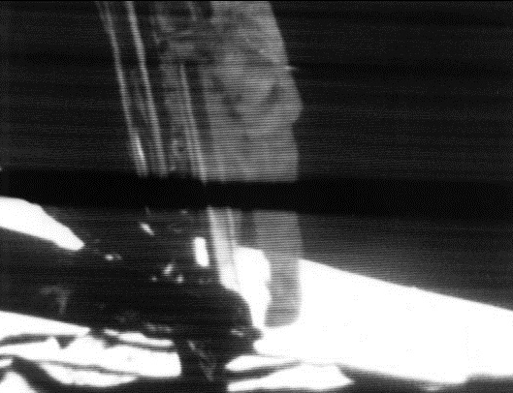
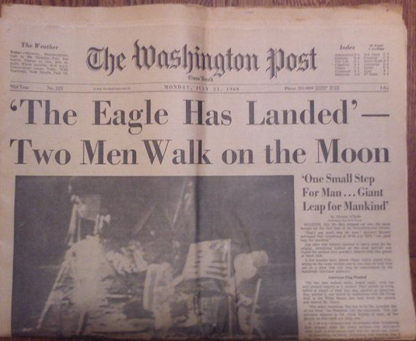
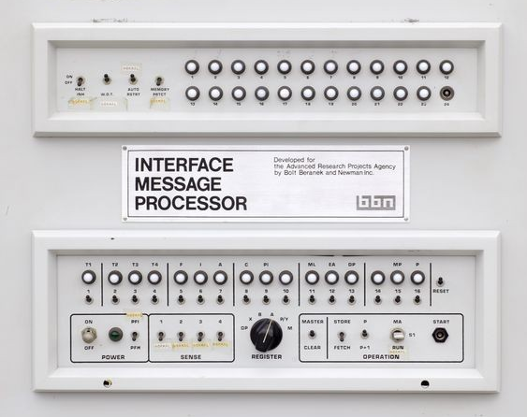
October 29, 1969
July 20, 1969
Notes:
Nearly 50 years ago, we put a man on the moon. That momentous event was accompanied with pithy, quotable quotes: “The eagle has landed”, “One small step for man, …”
Around the same time, nearly 50 years ago, the Internet (then called the ARPANET) sent its first data packet. The event was accompanied with a far less quotable quote: “lo…” (the successful word ”login” was transmitted a few months later)

Slide 3
What is the Internet?

Slide 4

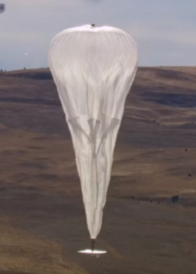


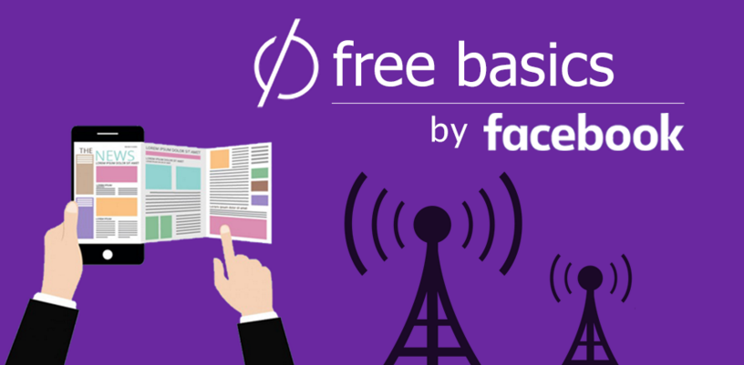

How does it all come together?

Slide 5
The Internet is “A Network of Networks”
AT&T
Princeton
Comcast
The Internet
Sprint
Level3

Slide 6
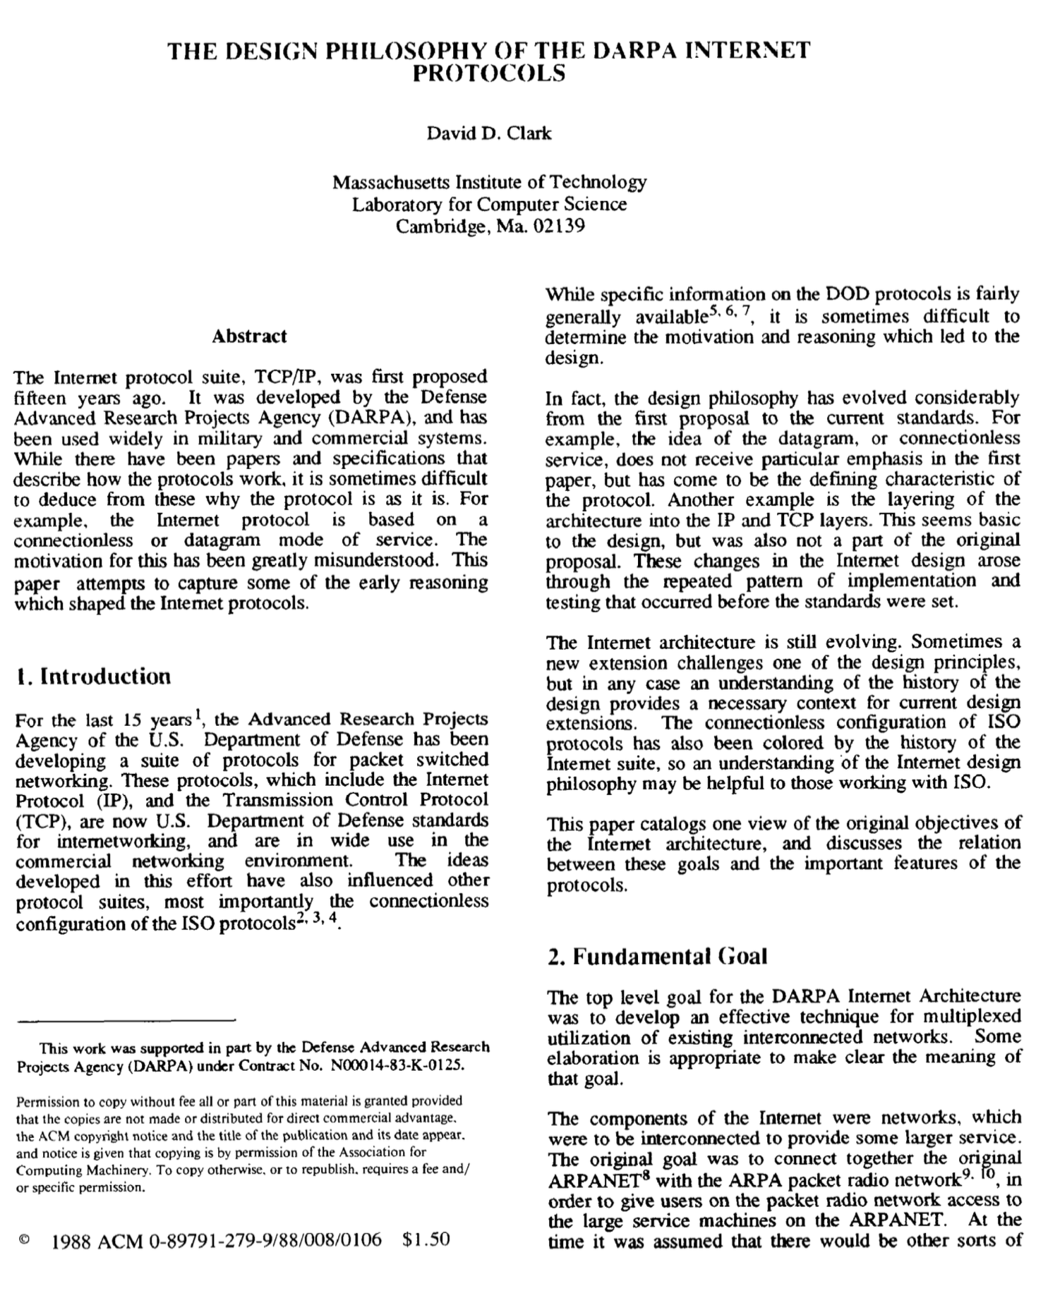
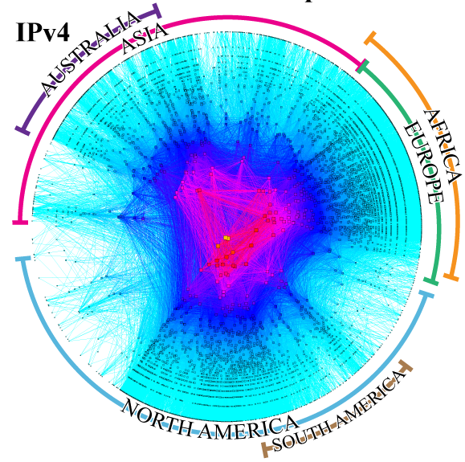
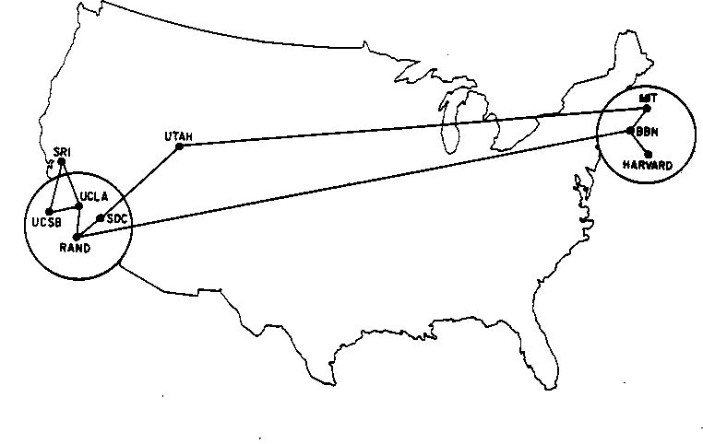
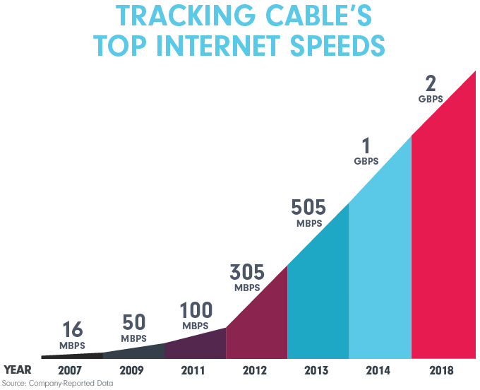
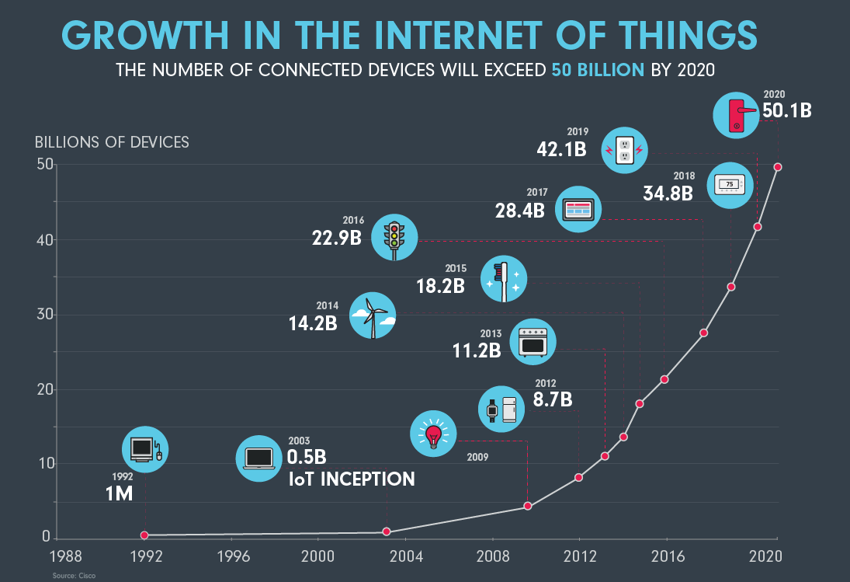
The Internet Moonshot
Bigger
Survivability
Reliability
Performance
Heterogeneity
Distributed Management
Faster
More “Things”
Notes:
When I first learned about the Internet’s architecture in a networking course in about 2000, the first reaction was how inspired the design is. Now, we teach the topic, but in a completely different way: In terms of what was left out.
Things were much different back then:
Network of trusted research universities
Few stakeholders (and no profits)
No security concerns
One government
Now, the Internet is bigger, faster, and more things are connected. The stakes are higher: for service providers (e.g., video), for advertisers (those who want our data), for attackers, and citizens of the world who rely on the Internet for information.

Slide 7
Three Challenges for the Modern Internet
Make it usable.
Make it trustworthy.
Make it private.
Notes:
In this talk, I will talk about how these changes have brought forth three new challenges, discussing goals that were not foreseen in any of the early Internet design documents.
First, usability is a foremost concern. There are many aspects of usability, of course, and I’m going to focus on a relatively low-level aspect: performance, but particularly performance as it relates to things that users/consumers care about.
A second concern is trustworthiness, one aspect of which involves protecting users from unwanted messages. In the “early” days, that meant email spam. Now, it means “disinformation” (“fake news”), which, as I will discuss, bears some surprising similarities to spam, in terms of the campaign characteristics, and how we fight it.
Finally, a paramount concern is privacy. Privacy is, of course, hard to define (it has many definitions), and the problem is not 100% technical. It crosses over into policy, law, economics, and other disciplines. But in this talk I will focus on how various technical interventions can help move us towards this grand challenge.
In all three cases, my approach is similar. I start by asking a seemingly simple question, and apply empirical methods to slowly pull back the curtain on the more complex aspects of the question. All of these projects I will discuss involve building and deploying systems to facilitate large-scale data collection. That is a theme throughout my work, even topics that I don’t have time to discuss today.

Slide 8
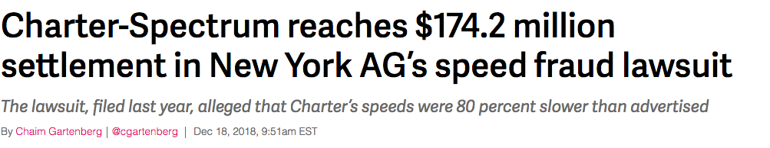
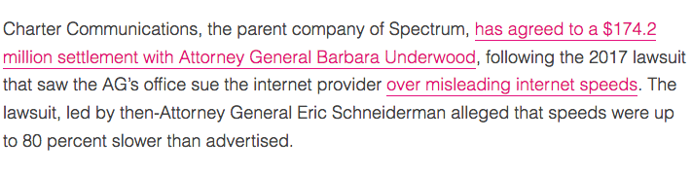
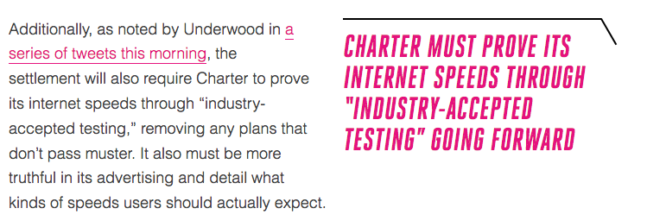
Notes:
Let’s start with the question of usability, with a focus on broadband Internet speeds.
You may have seen that the NYAG recently settled a case with Charter Communications in NY over “false advertising” of Internet speeds. I was involved in aspects of this case, and one of the really interesting things was that certain aspects of the complaint hinged on a very simple question: “Are users getting what they pay for/what is advertised?”
The conclusion, which you can see here, points to the need for “industry-accepted testing” going forward. One problem: There’s no such thing!
But, speed testing and measuring what the ISP can deliver is simple, right? Let’s have a quick look…

Slide 9
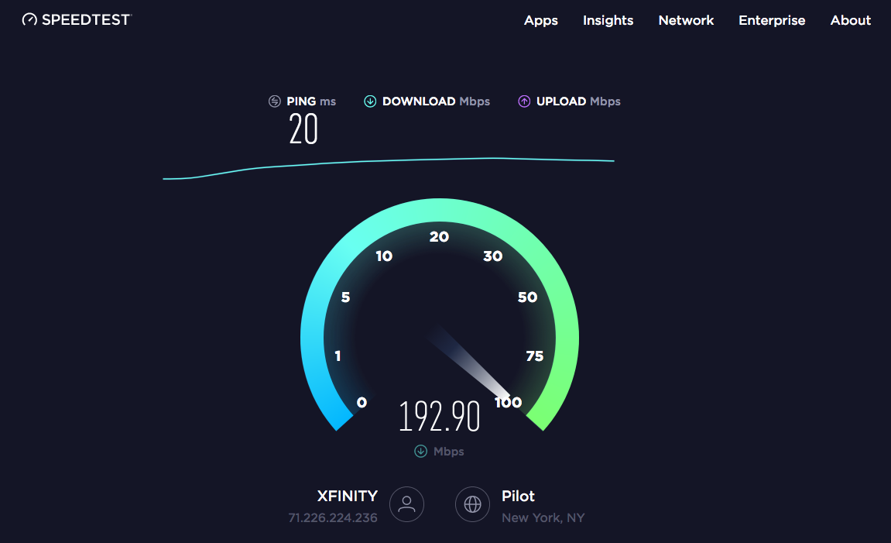
Notes:
Anyone run this tool?
This is Ookla’s “Speedtest” (speedtest.net), Seems simple enough.
But here’s one curious thing: On the first day of my networking course, I have students run this tool and report back the numbers that the tool reports. They’re on the same network, next to each other. And yet, even the same tool gives wildly different answers!
The seemingly simple question of “How fast is my network?” has never been easy, and it’s actually getting even harder, as I’ll describe shortly.
But, as it turns out, as the network gets faster and more services are deployed, this may not even be the right question…

Slide 10
In-Class Discussion
I want to watch a YouTube/NetFlix video on my phone.
Questions:
What steps are involved in finding and retrieving the content?
What determines whether I can see the content (or not)? (Think: Technology, Policies, …)
What determines the performance/quality of the resulting video? (Think: Technology, Policies, …)
Notes:
DNS
Local-area network (local wireless, etc.) + Local network (Ethernet, DOCSIS, …)
Routing. Intradomain and interdomain (business relationships)
TCP: reliable transport
Maybe some security (TLS)
Content distribution
Application protocols (HTTP, QUIC, SPDY, etc.)
What about throttling, censorship, net neutrality?
What about the other folks competing for bandwidth?

Slide 11
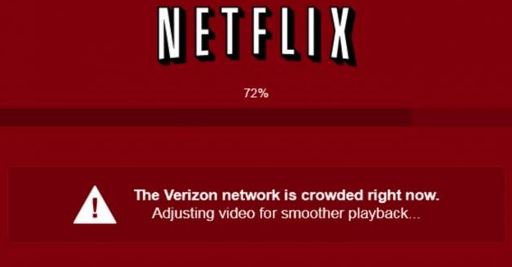
Users Care About Application Performance
Notes:
In fact, users care a lot about application performance. Getting high numbers on a speed test might be satisfying, but people jus want streaming video to work.
When it doesn’t, users aren’t happy… and as you can see, Netflix can sometimes point the finger directly at the ISP.
But it turns out measuring and studying application quality of experience (QoE) is not so simple.

Slide 12
Three Challenges for the Modern Internet
Make it usable.
Make it trustworthy.
Make it private.

Slide 13
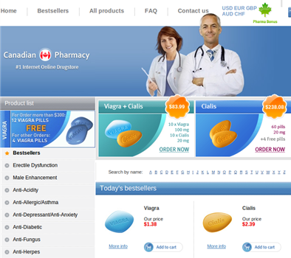
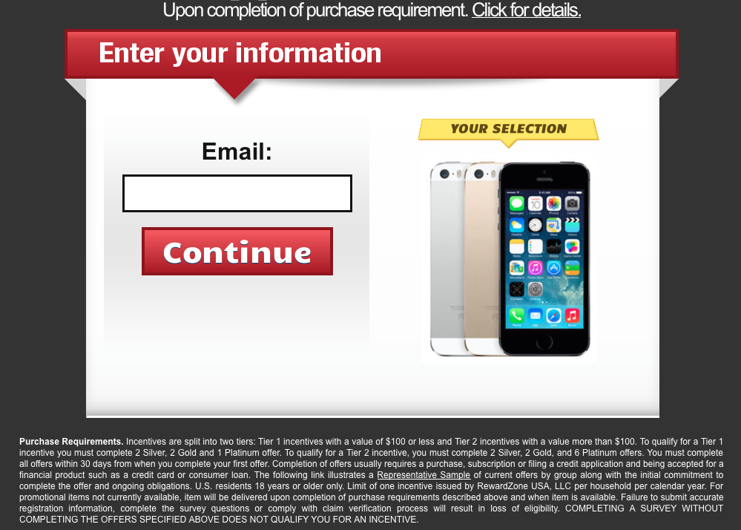
Financial Scams (Spam, Phishing, etc.)
Sale of illicit merchandise
Social cost
e.g., wasted time of users
$1 spammers’ revenue
≈ $100 cost to society *
Carrier of other attacks
e.g., phishing, spyware, trojans
Illegal online pharmacy
Fake website with bogus survey
*Rao et al. The Economics of Spam.
Journal of Economic Perspectives, Volume 26, Number 3, 2012
Notes:
95% of all email traffic remains spam. We don’t see it, but that’s because the spam filters are hard at work.
From a research sense, this is largely a solved problem, and I will talk a little bit about how our past work contributed to the solutions.
But, while in some ways the problem has been solved, in others it may have simply just moved elsewhere…

Slide 14
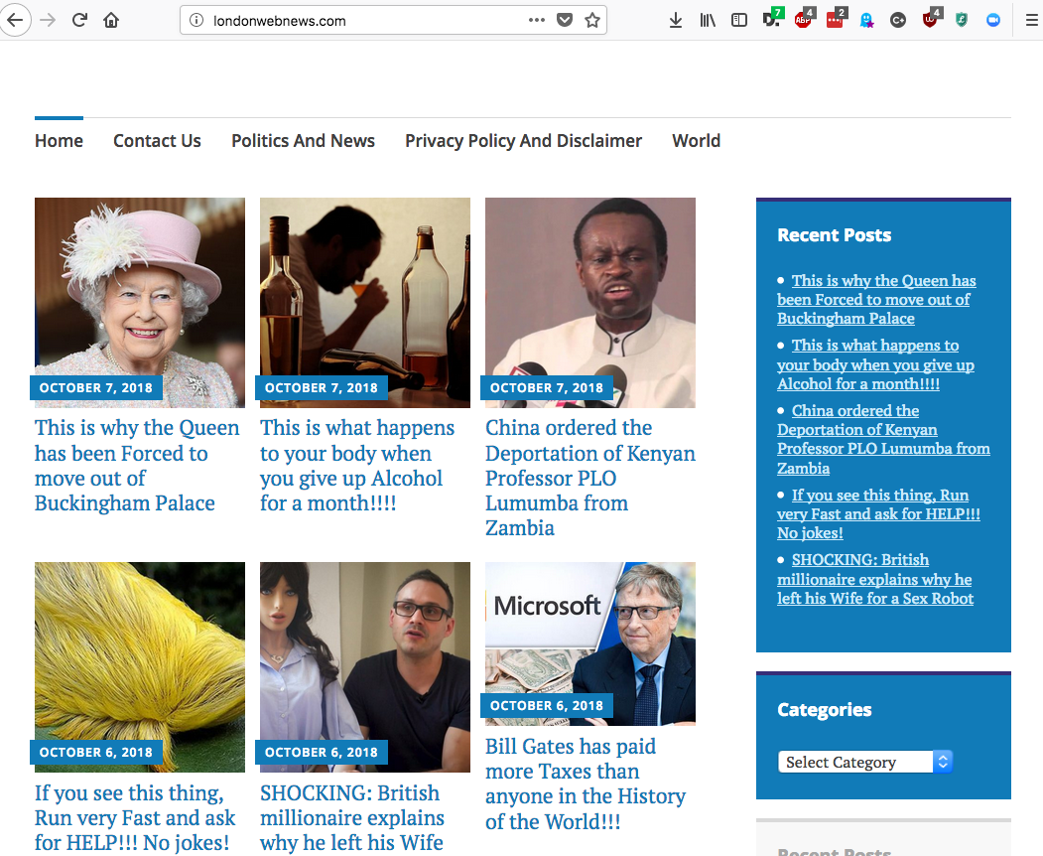
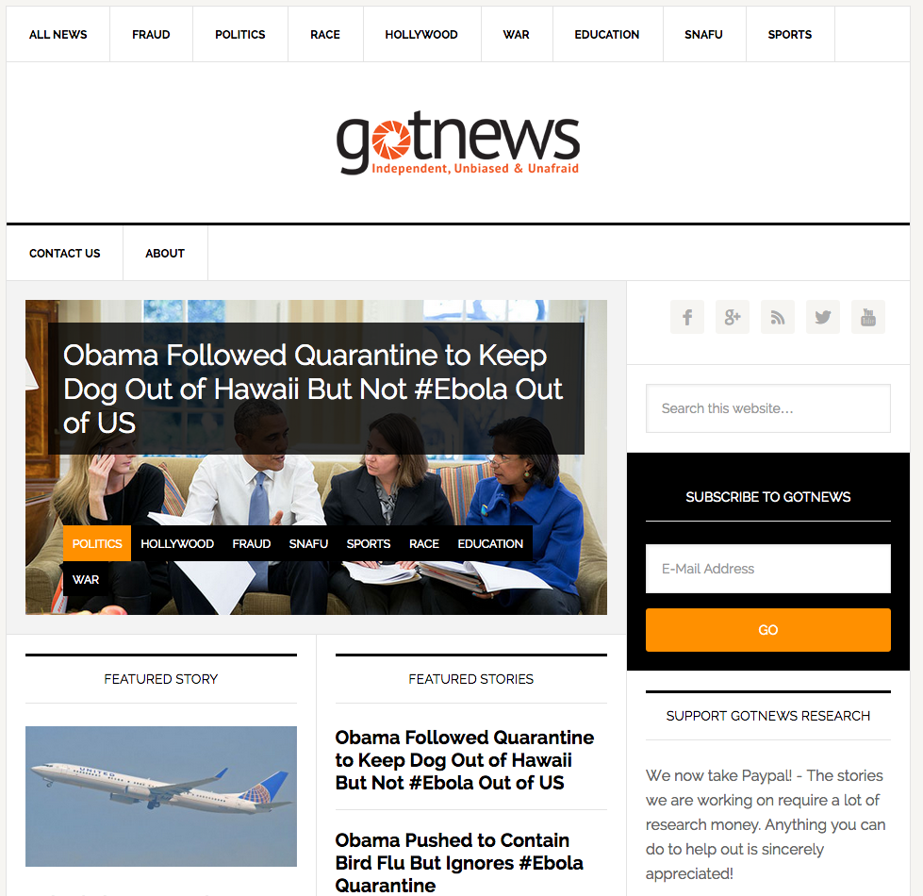
Information Scams (“Disinformation”)
Notes:
We’ve moved from financial scams to information scams.
Here are two websites that a tool that we are building identified as they were being posted on Twitter and Reddit. You’d be surprised how many of these sites pop up every day, but we are just deploying our tool this week, and easily tens of sites per week (and possibly more) are appearing. I’ll show you some more later in the talk.

Slide 15
Three Challenges for the Modern Internet
Make it usable.
Make it trustworthy.
Make it private.

Slide 16
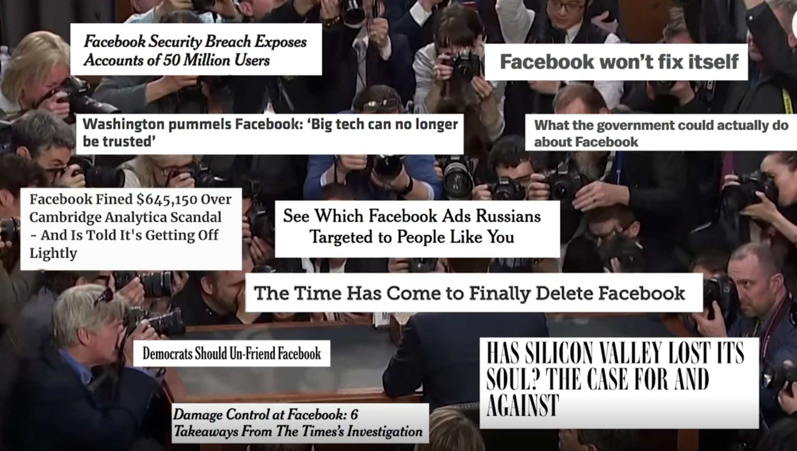
Notes:
This topic probably doesn’t even need motivation…but while it has reached a fever pitch lately, it is worth noting that companies like Facebook have been in hot water for a long time (practically since their inception).

Slide 17


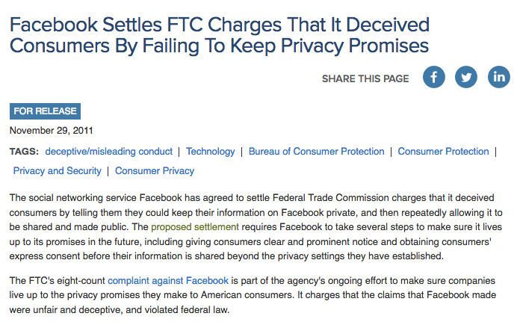
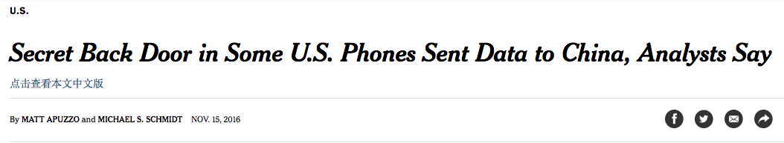
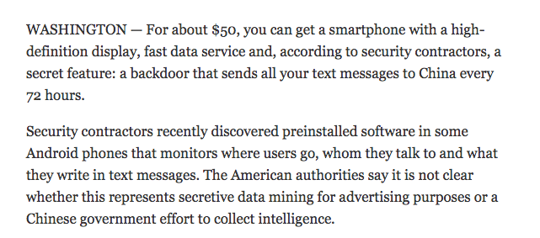
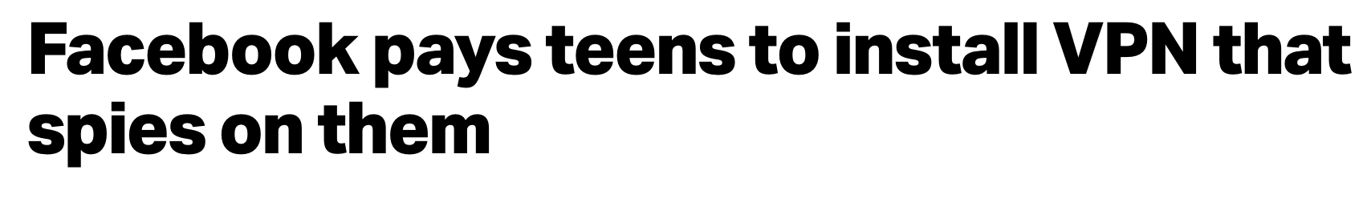
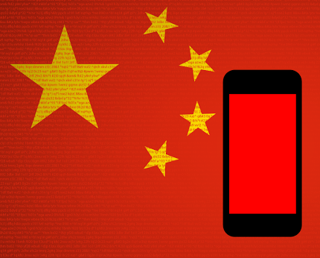
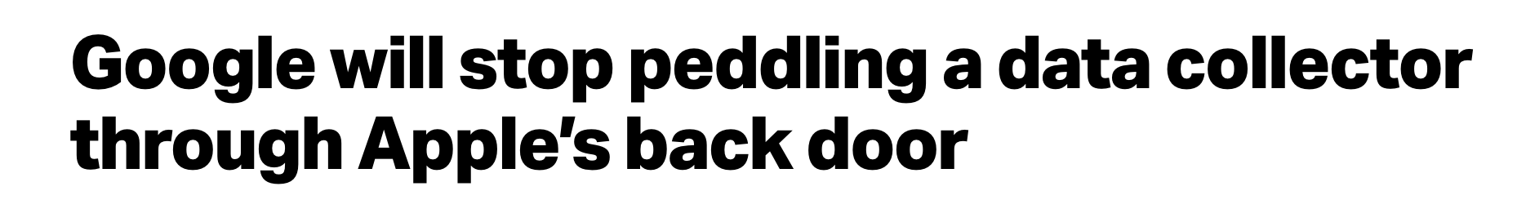
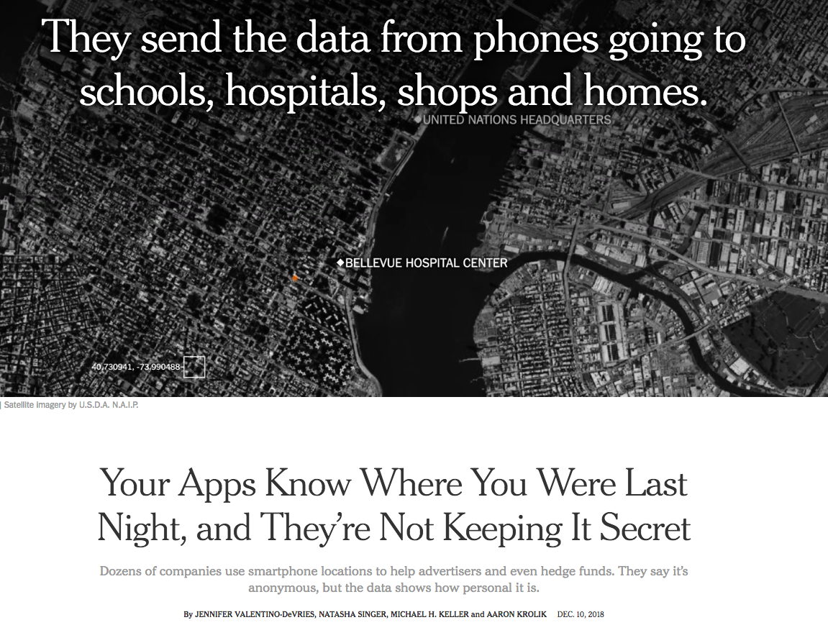
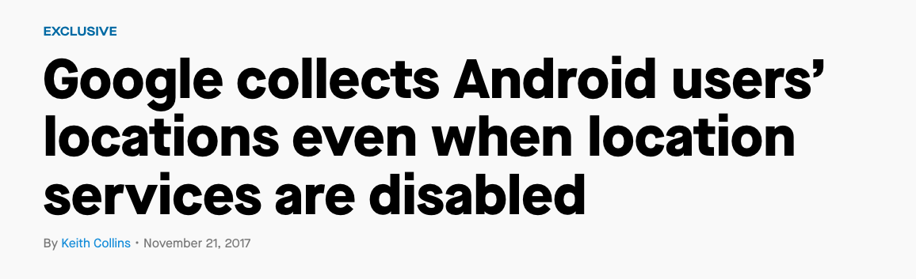
Notes:
In 2011, Facebook settled FTC charges regarding deceptive practices, resulting in a consent decree preventing Facebook from doing things that… well, they’ve since violated. Exciting times.
A lot of the action appears to be in smartphones, and as it turns out, even VPNs, highly touted as “protection”, are ineffective.
That’s an entire separate talk on work we are doing in that area, but I couldn’t resist adding just one more example: maybe people saw this week’s news about Facebook circumventing Apple’s privacy restrictions by deploying an enterprise app and then recruiting children to use it… (and it turns out there was another story yesterday that showed Google doing exactly the same thing… news from just yesterday).

Slide 18
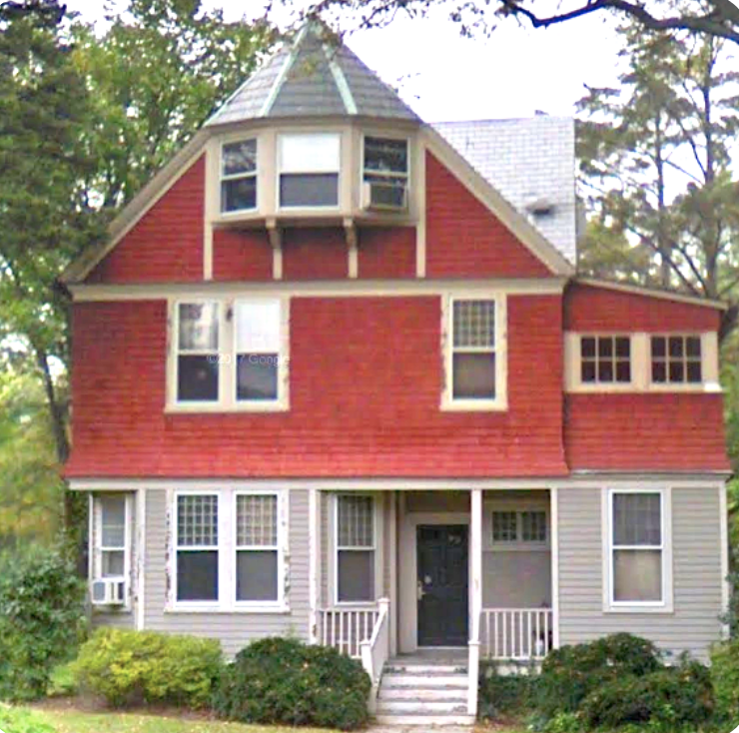
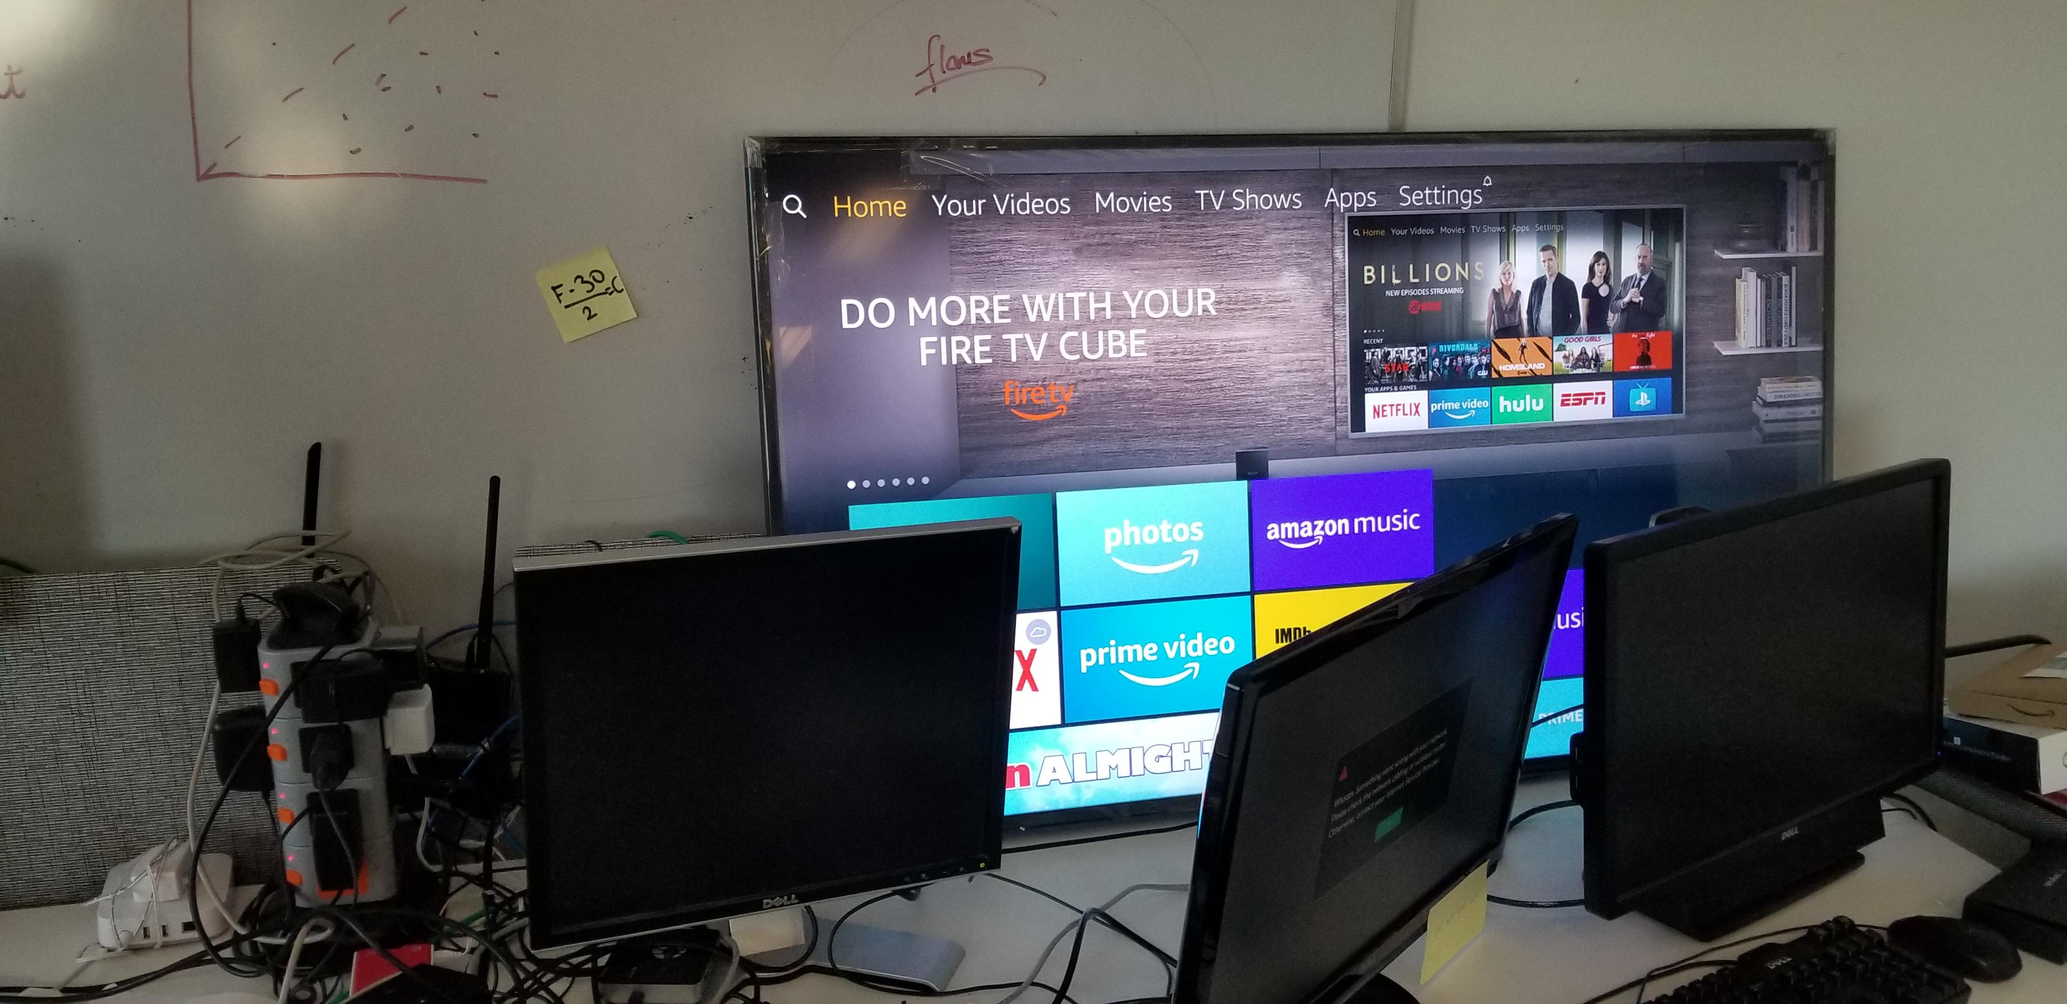
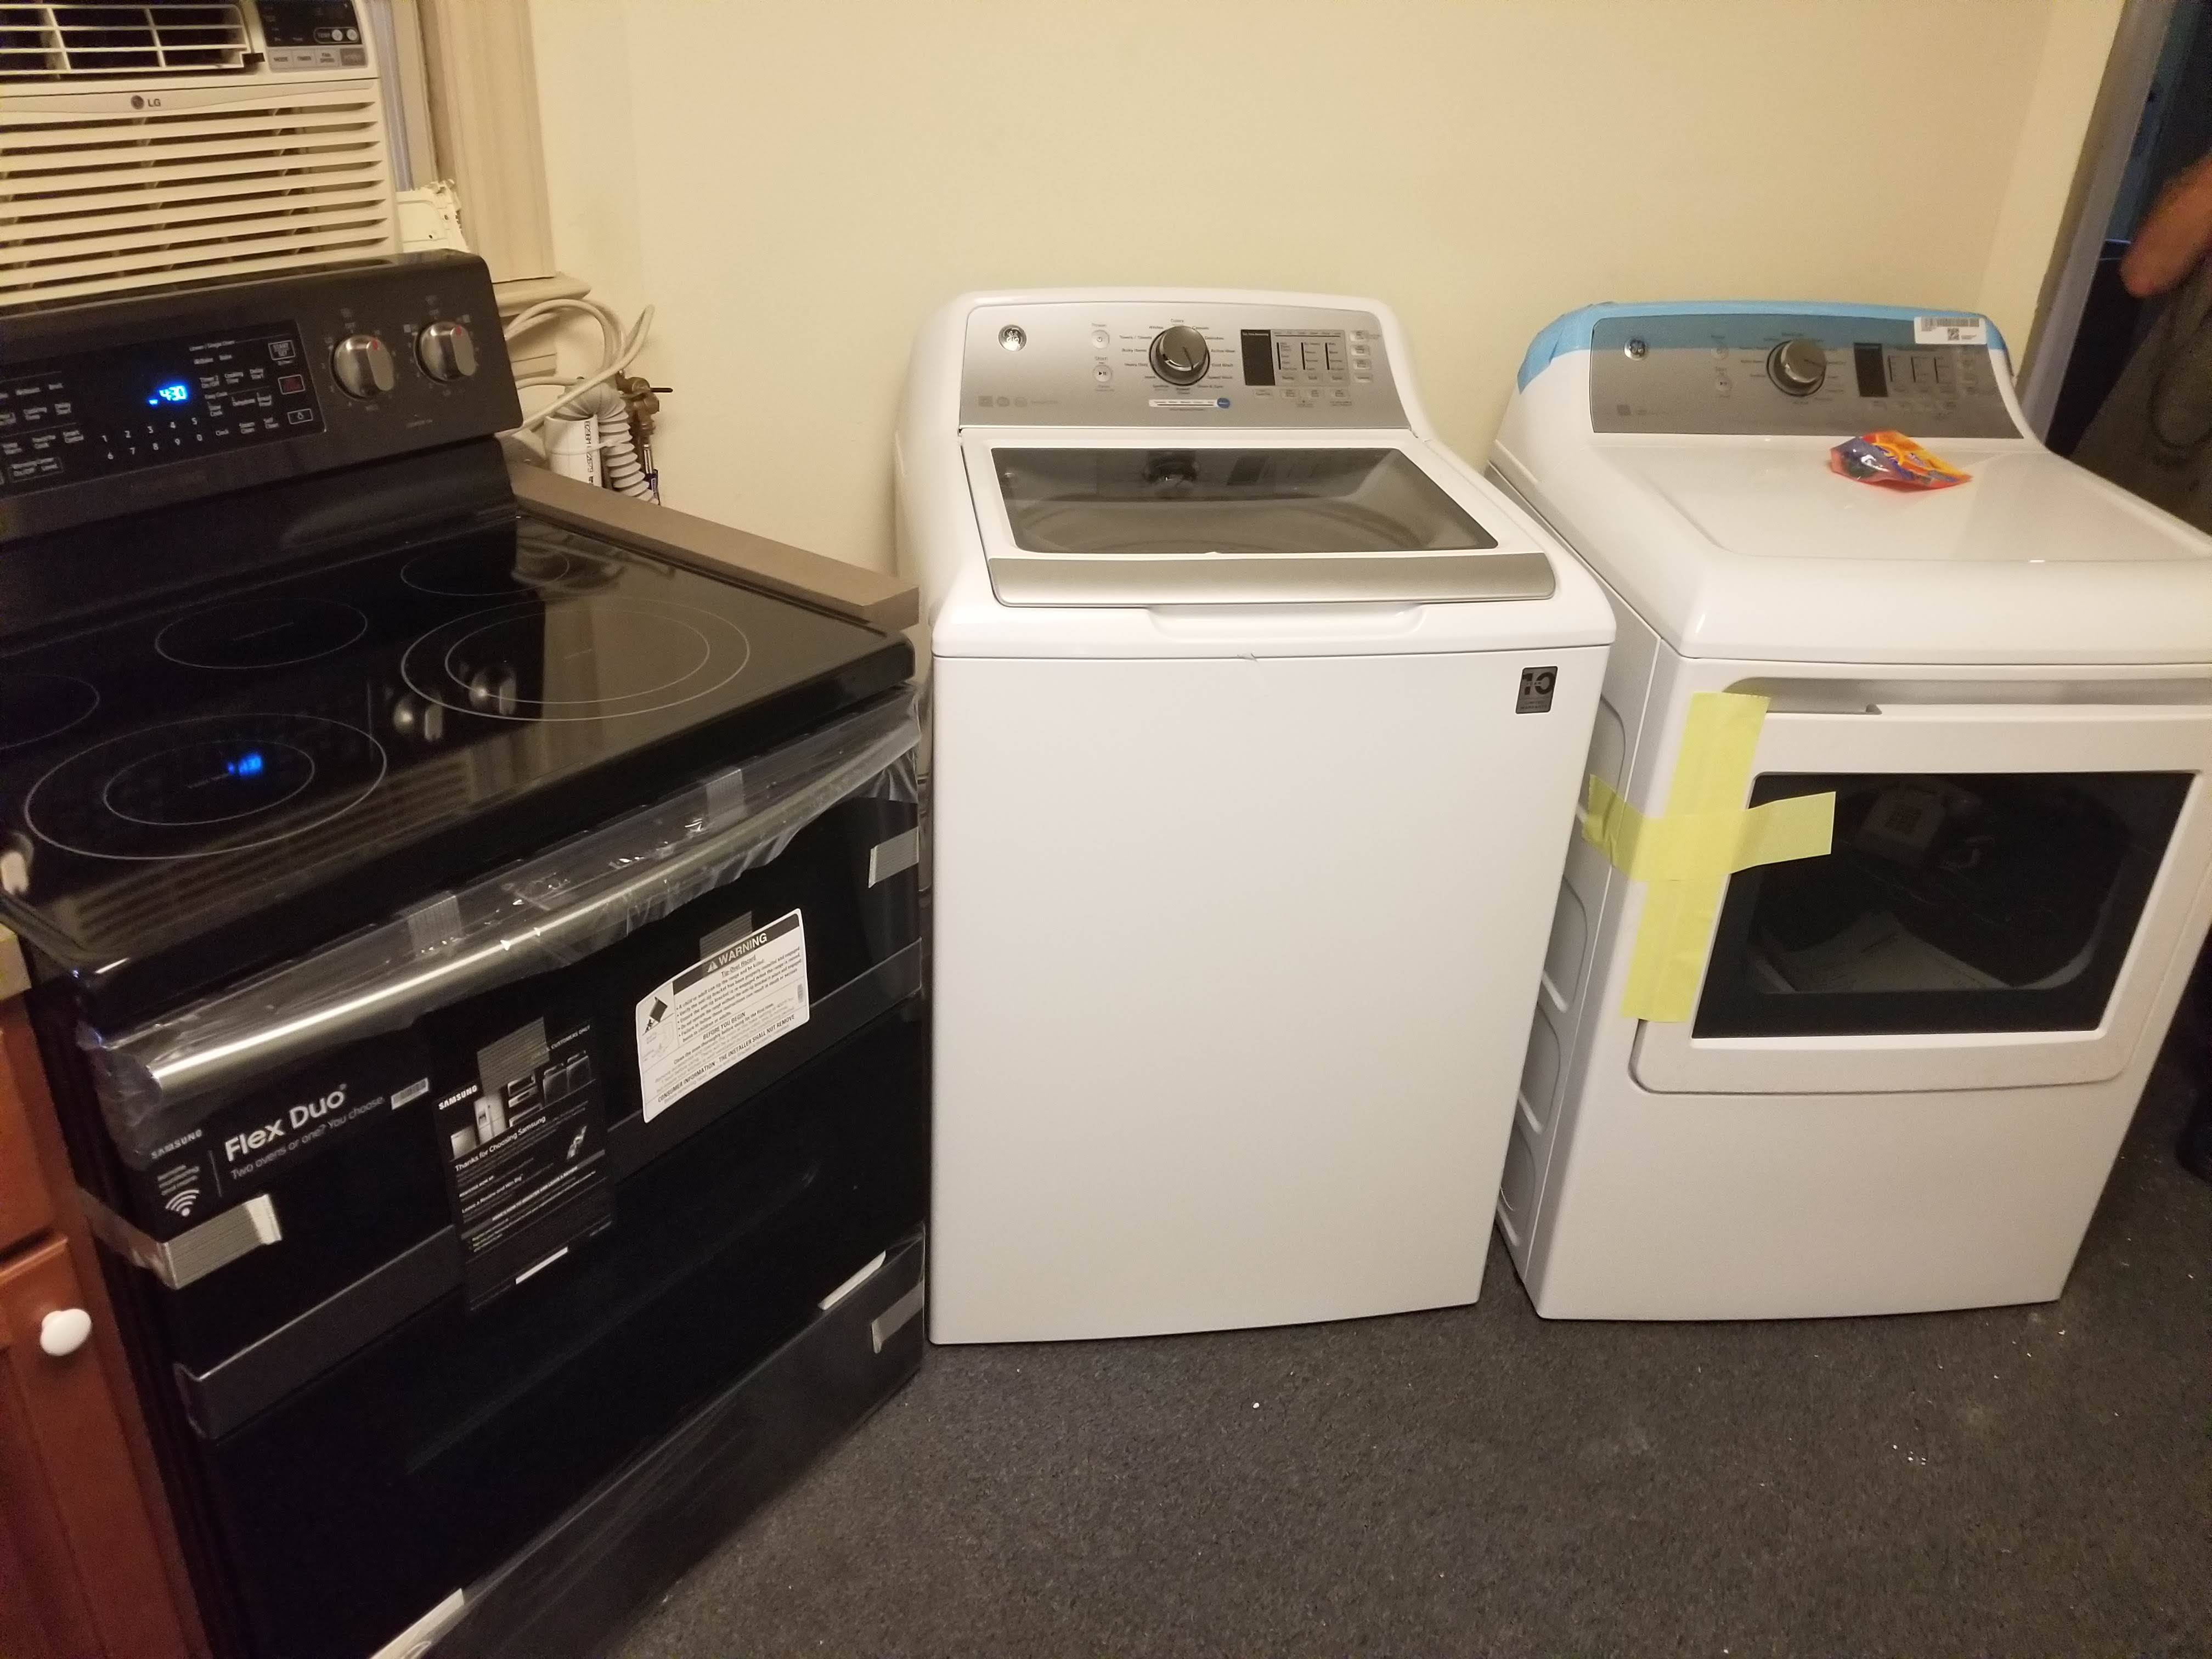
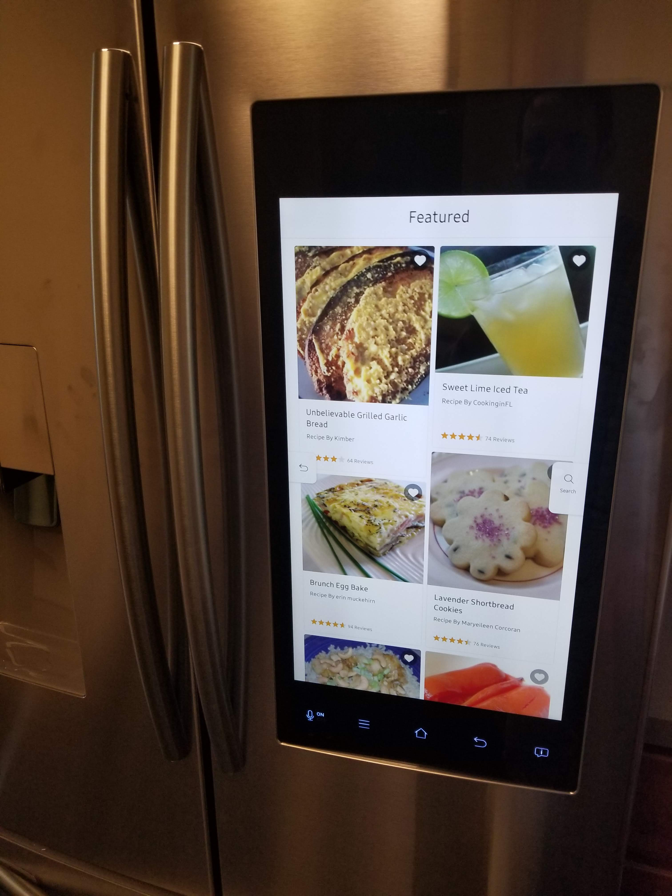
The “Smart Home”…
Notes:
And, it’s about to get worse. These are pictures from our “Smart Home Lab”, where we are studying the behavior of everything from smart TVs to smart fridges. More to come on that later in the talk…

Slide 19
Network: Evolving, Not Fixed in Stone!
“There is a tendency in our field to believe that everything we currently use is a paragon of engineering, rather than a snapshot of our understanding at the time. We build great myths of spin about how what we have done is the only way to do it to the point that our universities now teach the flaws to students (and professors and textbook authors) who don't know better.”
-- John Day

